Slide 1
Natural Language Processing
Saniya Jaswani & Ganesh Namagiri

Slide 2
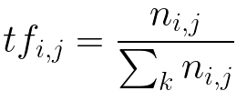
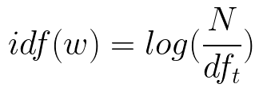
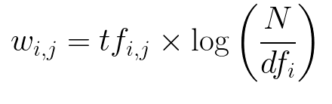
TF - IDF
Term Frequency – Inverse document Frequency
Aims to get words which are not frequent in every document but still are important
Term frequency - No of time word appears in a document/ no of total words in document
IDF – Log of no of documents divided by no of documents that contains word.

Slide 3
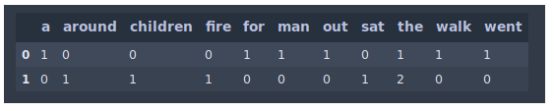

TF – IDF example
DocumentA = 'the man went out for a walk’ DocumentB = 'the children sat around the fire’
Bag of Words – ‘the, man,went,out,for,a, walk,childer,sat,around,fire’
Matrix
After Calculating TF-IDF
Since the is present more frequently it has lesser importance in both document.

Slide 4
Sentiment Analysis
Process to detect, positive or negative sentiment in a text.
Customer express their feedback more on Twitter, mail, survey or social media this process helps gathering information and gives conclusion about products
Business now spend million dollars to know feedback of any new product launch or sentiments flowing in Twitter.
How does it works ?
Rule Based – Human crafted rules which identifying polarity, subject of opinion. Count no of positive, negative and neutral words and sum to give whole statement a sentiment score. Here we use tokenization, POS, stemming and parsing.
Automatic – ML has various techniques to detect , polarity of statement. Where a classifier is fed a text, and it returns – positive, negative or neutral
Hybrid- Combination of Rule based and automatic, gives more accurate results.

Slide 5
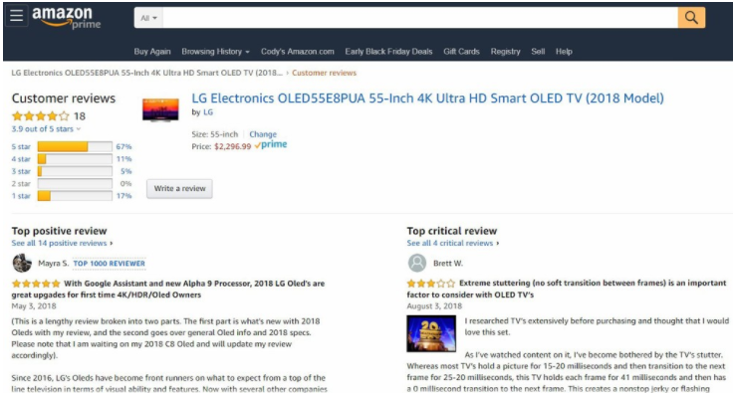

Slide 6
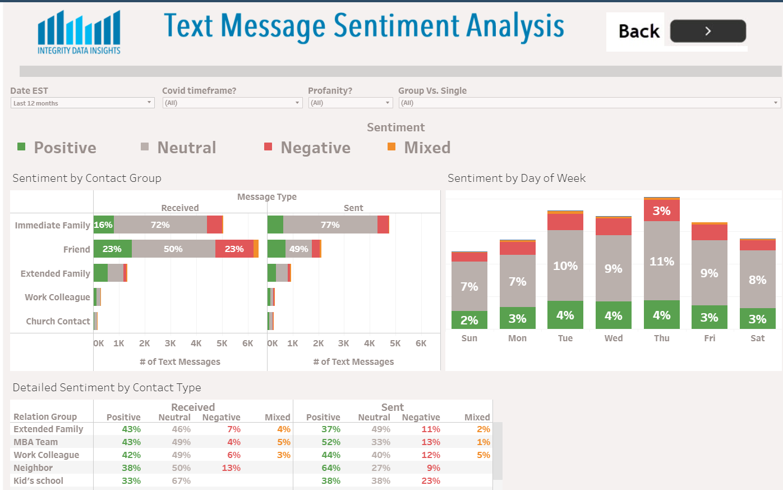
Link

Slide 7
Text Classification
Classifying corpus into various labels. It can be classification into two groups – Positive or negative. Or more groups – Politics, Education, Travel , Sports etc
Given a bunch of News articles, aim is to classify them into Fake News or Real ones
Examples
Government has announced 7 days curfew in Maharashtra, Author – TOI, Date –’2/4/2021’,url – ‘https://xyz’ – REAL
Government plans to soon allow vaccine for all age groups, Author – ‘NewsDuniyaBlog’, Date – ‘’, url – ‘’ – FAKE
CM will give away 12000 rs to everyone who has suffered in covid times, Author – ‘Whatsapp’, Date- ‘Today’, - FAKE

Slide 8
NETFLIX CASE Study
Given dataset of Movies and Tv Shows details
Find Best Rated moves
Generate a recommendation system
Show me movie trends in India
Analysis - https://www.kaggle.com/saniyajaswani/netflix-eda-and-recommendation

Slide 9
US Election 2020
Given tweets from US elections of Joe and Trump
Find positive/neutral/ negative tweets
Estimate winner based on trends in tweets
Find which area has popularity of Joe and Trump.
Analysis - https://www.kaggle.com/saniyajaswani/2020-us-election-tweets-analysis

